Slide 1
Street Use Permit Process Secondary Reviewer Training

Slide 2
Agenda
Street Use Permit Process and Roles
Two Parts to Completing Secondary Review
Bluebeam for document review
Accela for time entry and task status
Job Aids for Your Reference

Slide 3
Agenda
Street Use Permit Process and Roles
Two Parts to Completing Secondary Review
Bluebeam for document review
Accela for time entry and task status
Job Aids for Your Reference

Slide 4
Street Use Permit Process
Secondary Review is part of the review process of the Street Use permit process
The Street Use Primary Reviewer manages this part of the permit process

Slide 5
Street Use Permit Process Roles
The Primary Reviewer is the Street Use reviewer responsible for managing the permit/project
The Primary Reviewer is responsible for reviewing what their work group is assigned to review
The Secondary Reviewer is required when the scope of work goes beyond the Primary Reviewer work group’s roles and responsibilities
The Secondary Reviewer is responsible for reviewing what their work group is assigned to review
A Secondary Reviewer can be another Street Use work group, division, department, or agency
The Primary Reviewer is responsible for reviewing, consolidating, and resolving conflicts from all reviewer’s comments

Slide 6
Secondary Reviewer Role
Secondary Reviewer process includes:
Document review, mark-up, and resulting in BlueBeam
Time entry and task resulting in Accela

Slide 7
Agenda
Your Role as a Secondary Reviewer
Two Parts to Completing Secondary Review
Bluebeam for document review
Accela for billable hours and task status
Job Aids for Your Reference

Slide 8
Finding your Review
If the Primary Reviewer selects your team as a required Secondary Reviewer, the below email will be sent to the email address assigned to your work group
Record Number
Address
Review Due Date
BlueBeam ID & Link

Slide 9
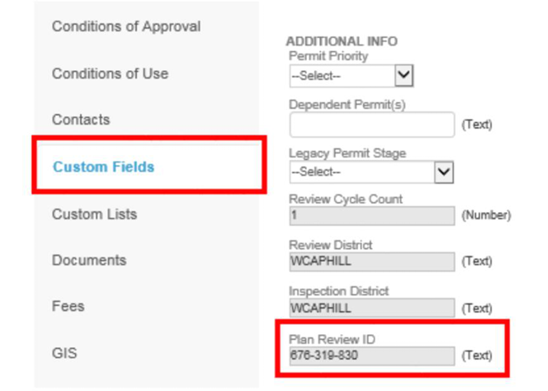
Finding your Review
Alternatively, the BlueBeam session can be found on the permit in Custom Fields in the Plan Review ID box

Slide 10
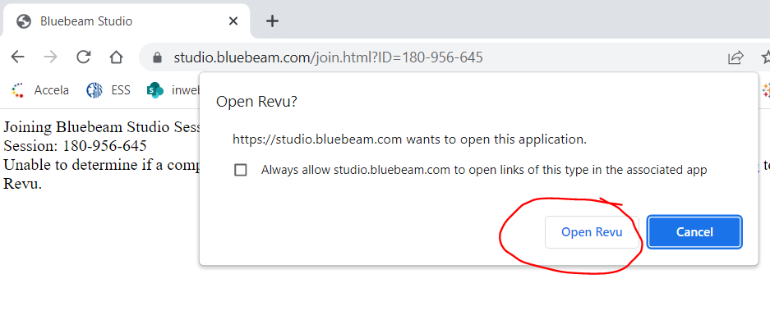
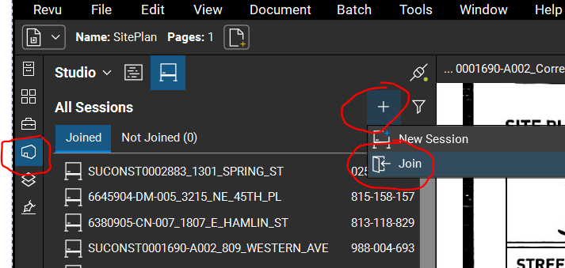
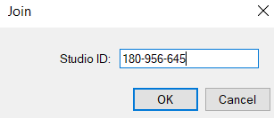
Opening the BlueBeam Session
Option 1: Join through the email notice:
Click the Session ID link
Click the Open Now button
b
Option 2: Join through BlueBeam
Open BlueBeam
Click on the XX tab
Click on the + symbol
Click the Join button
Enter the BlueBeam session ID
Click the OK button
c
b
d
e
f

Slide 11
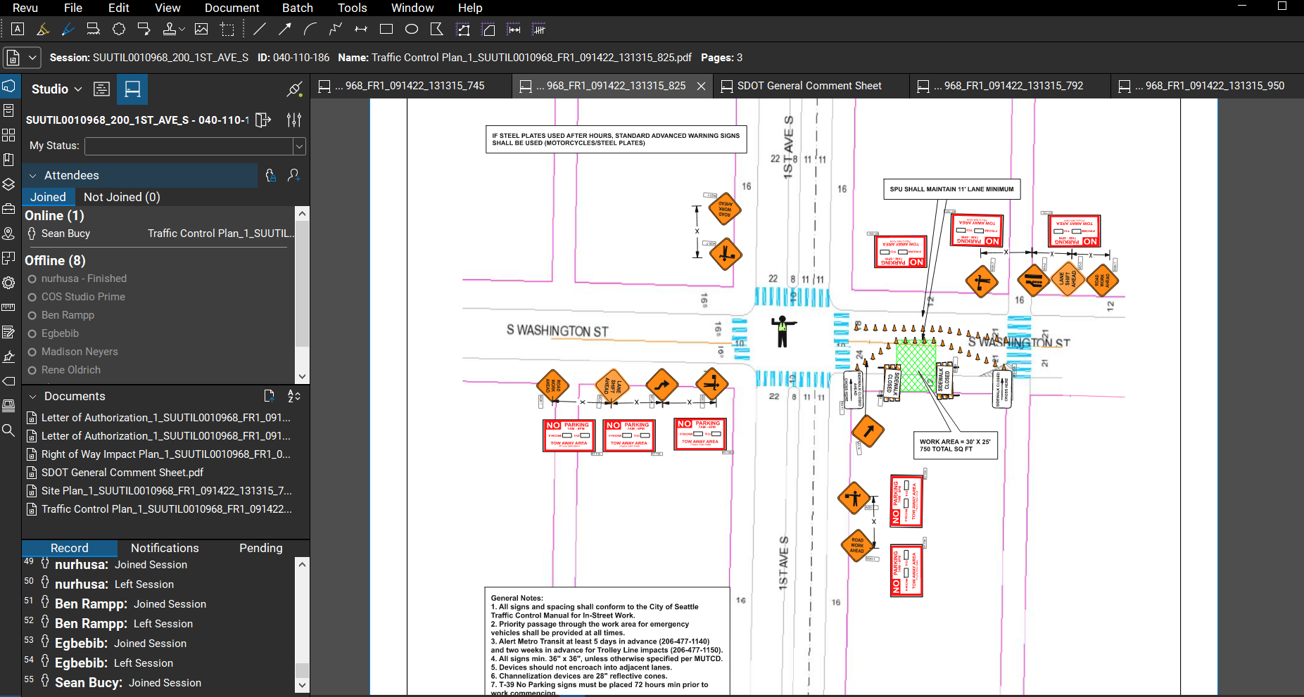
BlueBeam Application
Session info
File/Save/Tools
Document View

Slide 12
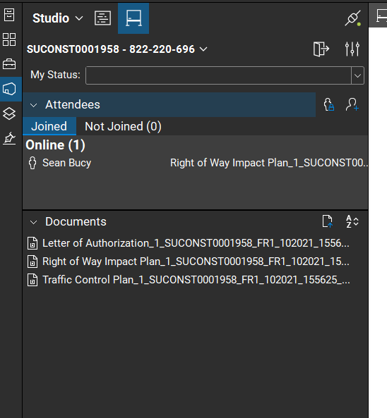
BlueBeam Session Orientation
Session name and ID#
People who have joined the session
Documents submitted for review
(Clicking on the documents from this list will open the document in BB)

Slide 13
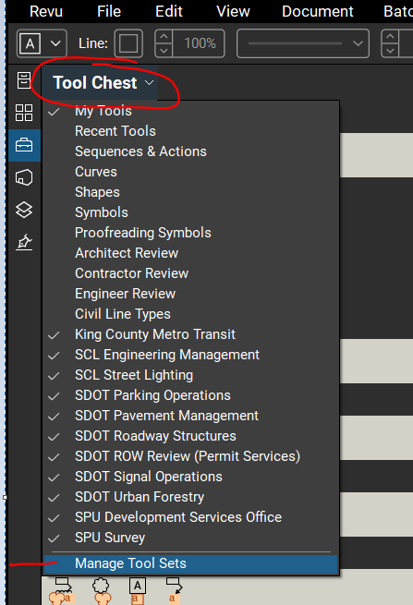
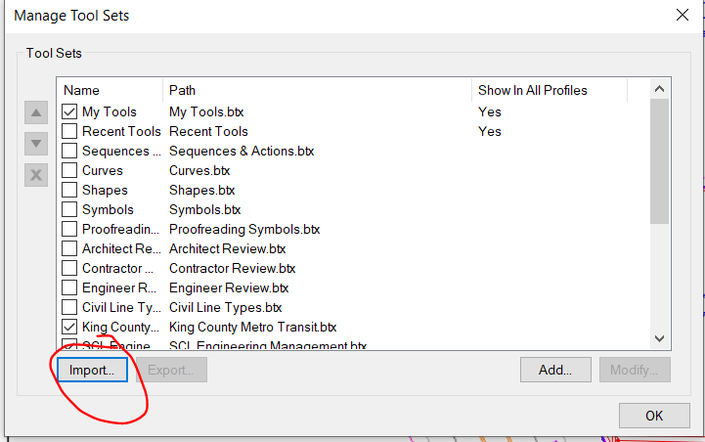
BlueBeam Session Orientation – Tool Chest
Tool Chests are used for efficient mark-ups
Each workgroup has their own tool chest color for quick identification and clarity
To add the Tool Chest:
Click on Tool Chest tab
Click on the Tool Chest carrot and select Manage Tool Sets
Click the Import button
a
b
c

Slide 14
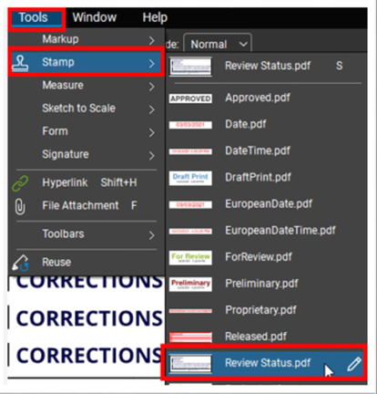
BlueBeam Session Orientation – Status Stamp
The Review Status stamp is used to document the result of the review in BlueBeam
To import the Review Status stamp:
Click on the Tools tab on the top toolbar
Click on the Stamp carrot and select Review Status
a
b

Slide 15
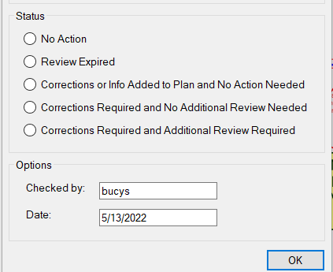
BlueBeam Process
1
When you begin your review, change My Status to Reviewing
Use your team’s Tool Chest to mark-up and comment on each document (if applicable)
When finished:
Change My Status to Finished
Add the Review Stamp, select the applicable result
This will be the same result you use in Accela
Click the OK button
3a
3b
3c

Slide 16
Review Status Options
Corrections or Info Added to Plan and No Action Needed to indicate that corrections or information were added to the plan and no action is needed.
Corrections Required and Additional Review Required to indicate the application does not satisfy the requirements of the Review and an additional review is required after the corrections are submitted.
Note: Setting a Review task to any of the Corrections Required statuses does not trigger an email to the Applicant.
Corrections Required and No Additional Review Required to indicate the application does not satisfy the requirements of the Review but no additional review is required after the corrections are submitted.
No Action Required to indicate the application satisfies requirements of the Review.
Review Expired to indicate reviewer never made comments but the review is considered complete
Do not use this status for the Primary Review task
Notes:
This slide shows a list of the task status values available for primary and secondary review tasks along with a short definition.
Please refer to the <009_JA_Workflow Task Status Definitions (SIP)> job aid or check with a SU Accela lead if you have questions about which task status to select for a review.
Setting any task status other than “In Process” will close/complete that review task.

Slide 17
Agenda
Your Role as a Secondary Reviewer
Two Parts to Completing Secondary Review
Bluebeam for document review
Accela for task status and time entry
Job Aids for Your Reference

Slide 18
Secondary Review Part 2: Accela
After document review in Bluebeam, update task status and add review time in Accela
How to find your (group’s) assigned task
How to reassign a task
How to complete your task
How to enter review time

Slide 19
Secondary Review Part 2: Accela
After document review in Bluebeam, update task status and billable hours in Accela
How to find your (group’s) assigned task
How to reassign a task
How to complete your task
Time Accounting

Slide 20
Finding Your (Group’s) Assigned Tasks – My Tasks Page
Click on the My Tasks Page. The default filter (My Assigned Tasks) displays a list of tasks assigned to you
Check the due date for your tasks (sort by clicking on the column header)
Don’t see the record you are looking for?
3. Click My Task Searching to search for tasks
Notes:
My Tasks page is a quick and easy way to find records that have a task assigned to you. Click on your pinned My Tasks page and a list of tasks assigned to you displays. To open a record, click on the blue linked Record #.
Next let’s look at how to search for tasks, using My Task Searching

Slide 21
Finding Your (Group’s) Assigned Tasks – My Tasks Searching – Department
4
1
2
3
Select SDOTSUPermits to see only tasks for Street Use permits
Clear the Assigned to Staff by selecting --Select--
Confirm that Department is correct
Click Submit
Notes:
I just clicked on My Task Searching. Let’s find tasks assigned to my Accela Department.
Select Record Type Group of SDOTSUPermit (important step or you may get an error message or tasks you don’t want)
Assigned to Staff and Current Department default to your name and Accela department. Clear your name by typing a dash and then selecting --Select--. Important since you don’t want to look for tasks assigned to you but any assigned to your secondary review group.

Slide 22
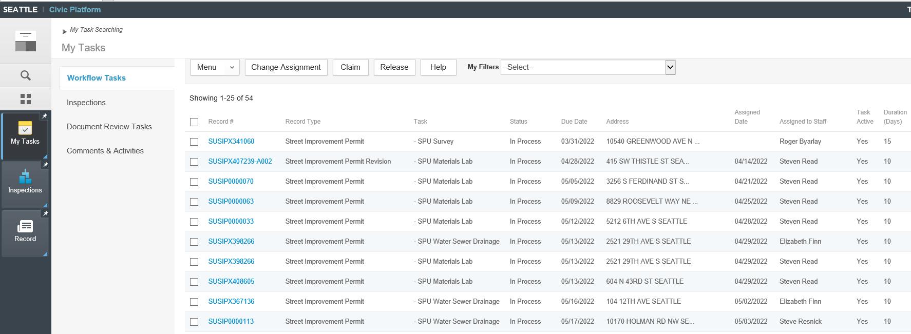
Finding Your (Group’s) Assigned Tasks – My Tasks Searching – Department Results
Tasks assigned to your Department are returned
This search works well if your Department has few tasks
Tip: Click the symbol to return to your search page
Notes:
My results are returned. I can see the task name, due date, and address.
I can click on a blue link to go to the record.

Slide 23
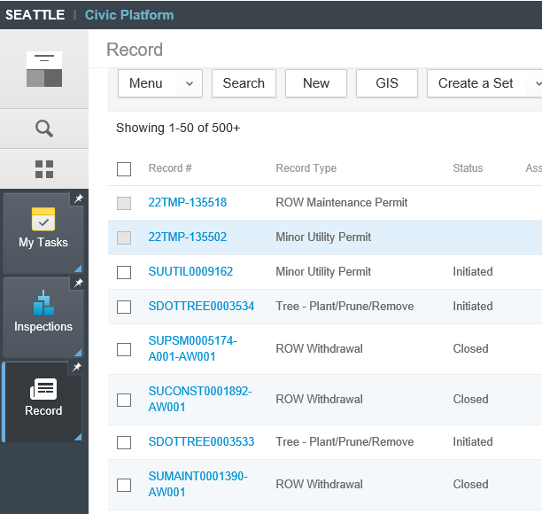
Finding Your (Group’s) Assigned Tasks – Record Search
From Record page click Search to open page for search criteria
Notes:
My results are returned. I can see the task name, due date, and address.
I can click on a blue link to go to the record.

Slide 24
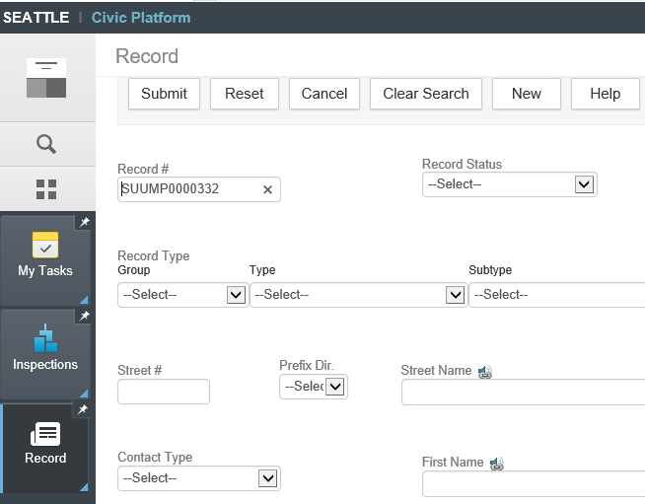
Finding Your (Group’s) Assigned Tasks – Record Search
Enter the record number (provided in your email)
Click Submit
Notes:
My results are returned. I can see the task name, due date, and address.
I can click on a blue link to go to the record.

Slide 25
Finding Your (Group’s) Assigned Tasks – Open the Record
Click on the blue linked Record # to open the record
Notes:
My results are returned. I can see the task name, due date, and address.
I can click on a blue link to go to the record.

Slide 26
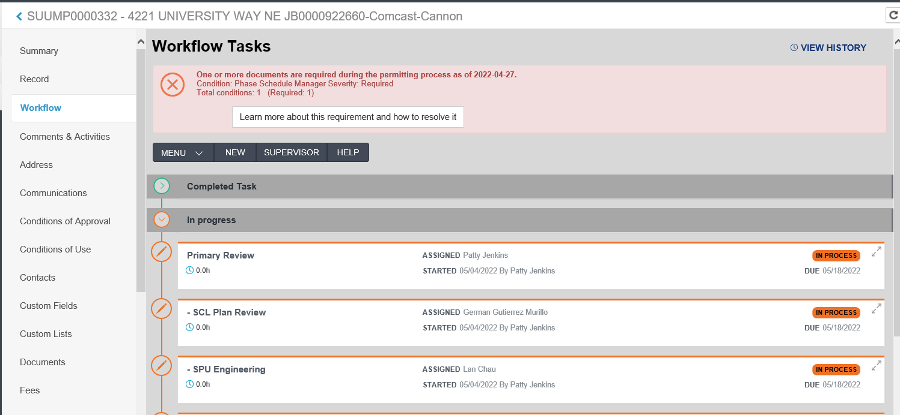
Finding Your (Group’s) Assigned Tasks – Open the Record
When the record opens, click on the Workflow Tab
Look for your task name. Because secondary reviews happen in parallel, you may need to scroll
Notes:
My results are returned. I can see the task name, due date, and address.
I can click on a blue link to go to the record.

Slide 27
Demo:
Find My Tasks
Find My (Group's) Task
Ex: SDOT CPRS Roadway Structures
Ex: DON Historic Hoods
Ex: Water Review
Search for Record
In Record Search
Open Workflow, open task

Slide 28
Secondary Review Part 2: Accela
After document review in Bluebeam, update task status and billable hours in Accela
How to find your (group’s) assigned task
How to reassign or claim a task
How to complete your task
Time Accounting

Slide 29
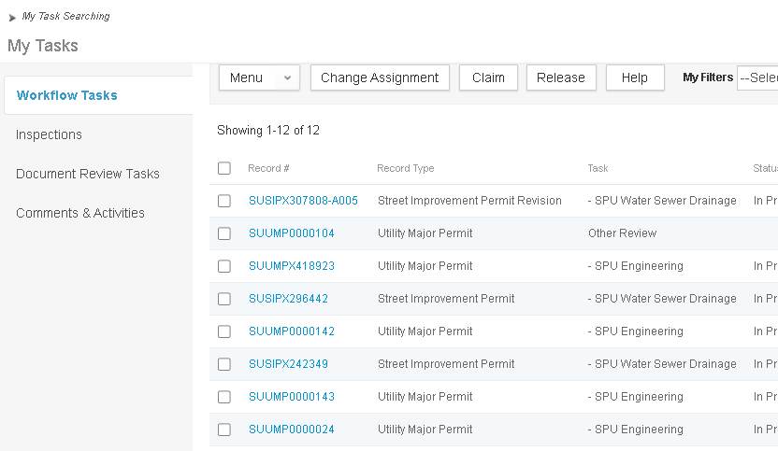
How to Re-Assign a Task
Re-Assign a task so it ends up in their My Tasks
In My Tasks
Select the record to reassign (beware, the target is very small)
Click Change Assignment (also available on the task when the record is open
TIP: you can select more than one record at a time

Slide 30
How to Re-assign a Task
In the pop-up
Click Current Department
Select Current User from drop down (notice all selected tasks can only be re-assigned to one person at a time)
Click Submit
On Submit, the task is reassigned and will show in somebody else’s My Tasks queue

Slide 31
How to Claim a Task
Claim a task so it ends up in your My Tasks and so you can bill time to the task
In My Tasks
Select the record to claim (beware, the target is very small)
Click Claim

Slide 32
Secondary Review Part 2: Accela
After document review in Bluebeam, update task status and billable hours in Accela
How to find your (group’s) assigned task
How to reassign or claim a task
How to complete your task
Time Accounting

Slide 33
How to complete your task
Add Time
Status Task
A few words on time
When added to the Task
Fewer clicks, fewer mistakes
No task comments to invoice
When added to Time Accounting
More clicks, more mistakes
Comments added to invoice
Combo = best of both worlds
IMPORTANT: In order to charge time to a task when you status it, the task must be assigned to you

Slide 34
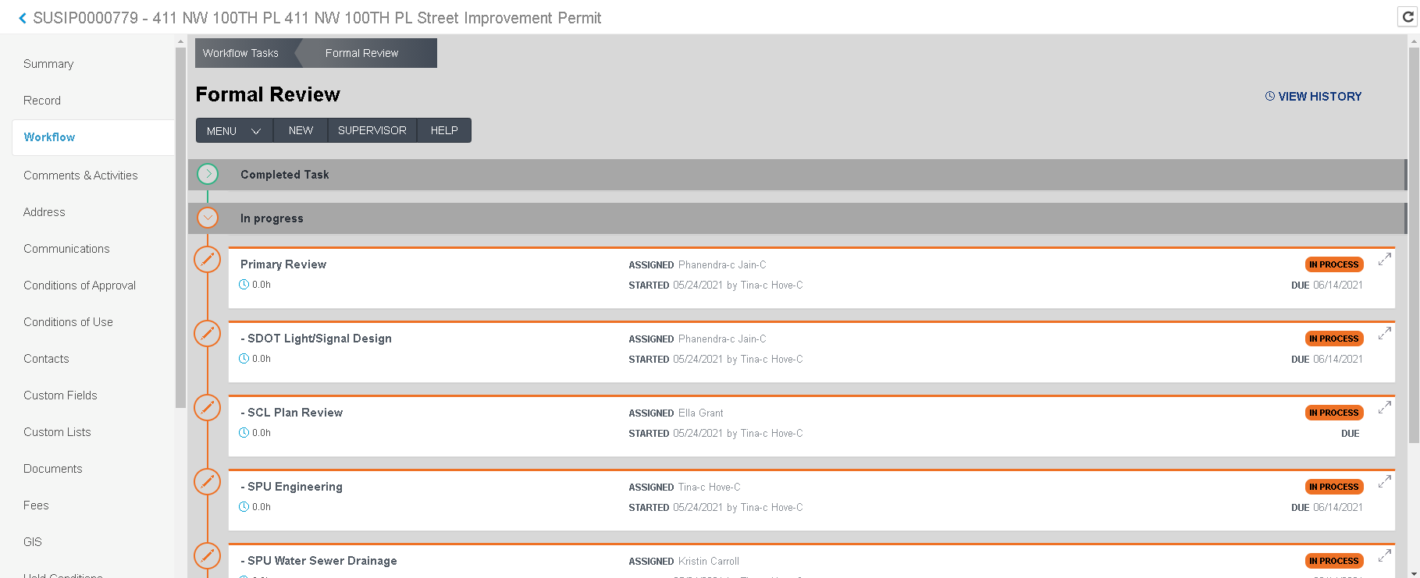
How to complete your task: Open Workflow Task
From the Workflow tab click anywhere in the task

Slide 35
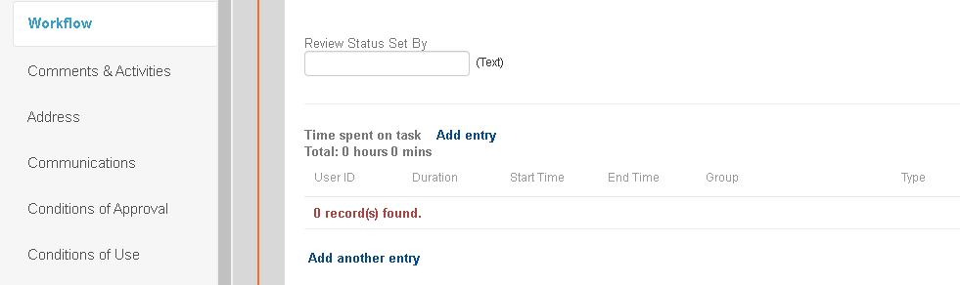
How to complete your task: Record Time
Scroll (way) down in the open task
Click Add entry

Slide 36
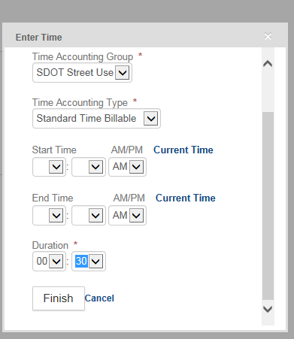
How to complete your task: Record Time
Select Time Accounting Group
Select Time Accounting Type
Enter Duration both hour and minutes, in 15 minutes increments
Click Finish
1
2
3
3
4

Slide 37
How to complete your task: Record Time
Time is entered but not saved or billable
Must status the task for Time to be billable
Notes:
This is what the screen looks like after you have added your time.
Notice: time is only at the bottom of the screen.

Slide 38
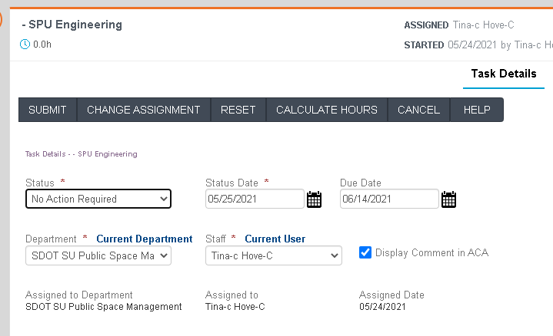
How to complete your task: Status Task
In the same Workflow task, scroll up to the top of the task.
Select appropriate status (see next slide for details).
Click Submit.

Slide 39
Task Status List
Primary and Secondary Review task status values:
Corrections or Info Added to Plan and No Action Needed to indicate that corrections or information were added to the plan and no action is needed.
Corrections Required and Additional Review Required to indicate the application does not satisfy the requirements of the Review and an additional review is required after the corrections are submitted.
Note: Setting a Review task to any of the Corrections Required statuses does not trigger an email to the Applicant.
Corrections Required and No Additional Review Required to indicate the application does not satisfy the requirements of the Review but no additional review is required after the corrections are submitted.
No Action Required to indicate the application satisfies requirements of the Review.
Review Expired to indicate reviewer never made comments but the review is considered complete
Do not use this status for the Primary Review task
The default status for reviews (primary and secondary) is In Process, this indicates that the review is ongoing, not yet complete. This status does not need to be manually set.
Setting any status other than In Process closes / completes that Review task.
Notes:
This slide shows a list of the task status values available for primary and secondary review tasks along with a short definition.
Please refer to the <009_JA_Workflow Task Status Definitions (SIP)> job aid or check with a SU Accela lead if you have questions about which task status to select for a review.
Setting any task status other than “In Process” will close/complete that review task.

Slide 40
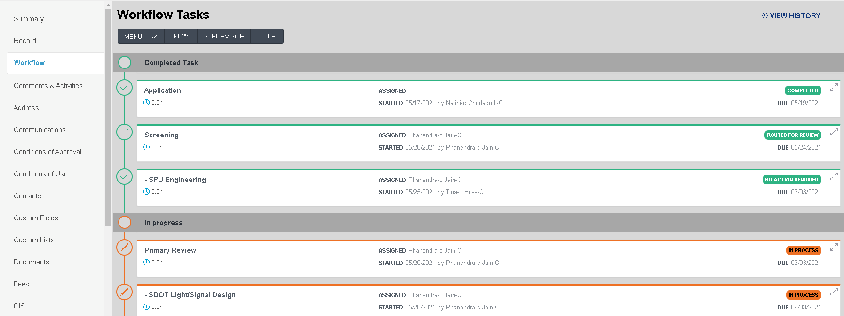
How to complete your task: Completed
A completed task turns from orange to green

Slide 41
Secondary Review Part 2: Accela
After document review in Bluebeam, update task status and billable hours in Accela
How to find your (group’s) assigned task
How to reassign or claim a task
How to complete your task
Time Accounting

Slide 42
How to Modify Billable Time in Accela
As a reminder, time is billed monthly (early the following month)
Your time can be modified until the entry is locked for billing
Job Aid 003 Add and Adjust My Time Entry
Notes:
Time is entered via the time accounting page in Accela. A batch job runs at the beginning of the month for generating fees and invoicing, so billable time needs entered in a timely fashion so it gets picked up by the job. Once the job runs, it locks the time record so changes cannot be made to the time, so be sure to modify the time as soon as you determine a change is needed.
<<< Note to trainer: Batch job runs on 1st day of month. >>>

Slide 43
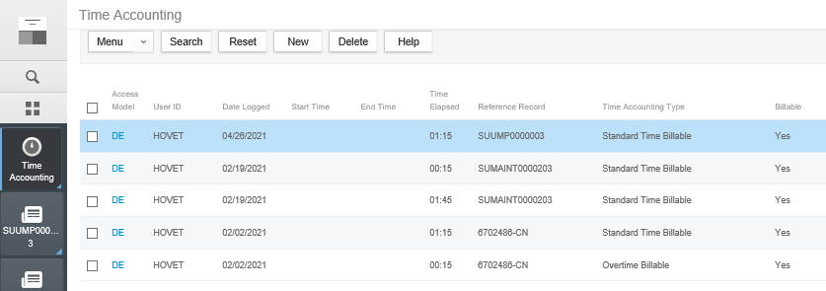
How to Modify Billable Time in Accela
…and add notes!
Open Time Accounting to see your recent entries
Click DE to open an entry

Slide 44
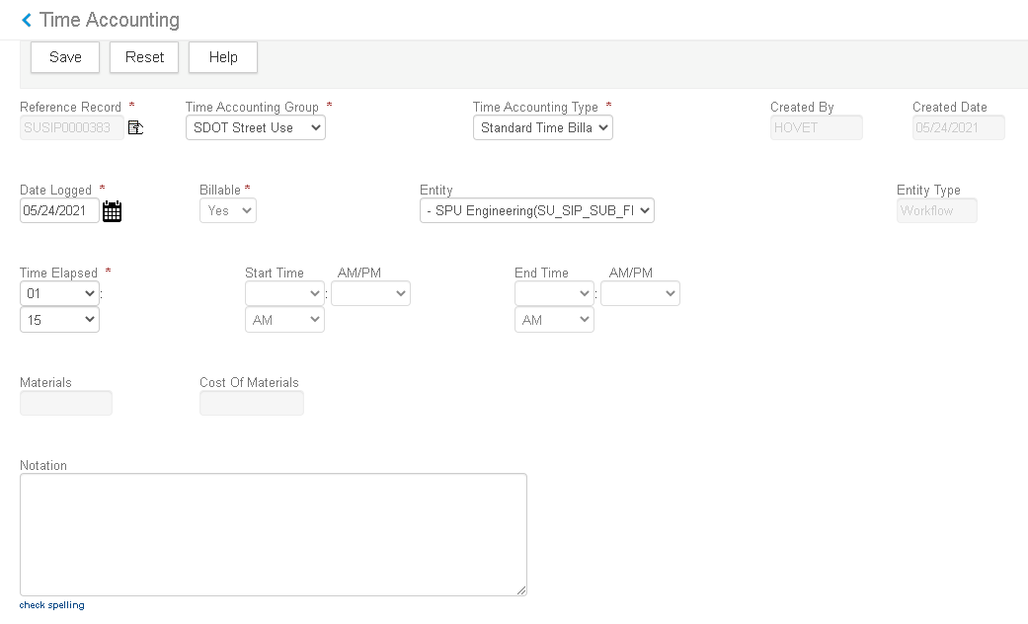
How to Modify Billable Time in Accela
Make edits in the opened time accounting entry including
Time Elapsed (Duration)
Notation (for the Invoice)

Slide 45
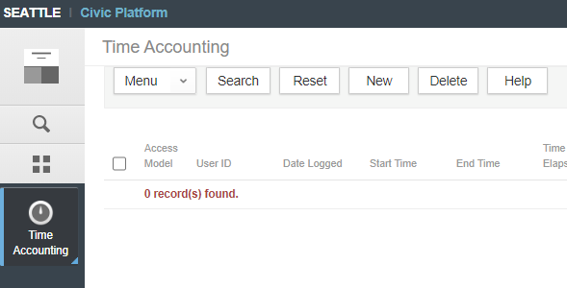
How to Add Billable Time in Accela
Open the Time Accounting page
Click New
2
1
Notes:
Time can be entered in a couple of ways. We will talk about entering time in the Time Accounting page. If you don’t have it pinned, you can get to it using the Launchpad (waffle) icon.
Job aid How to Add or Adjust My Time Using Time Accounting has all the steps if you forget how to enter your time. Click New to begin entering your time. <<< Read slide >>>

Slide 46
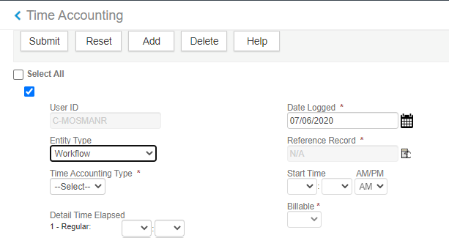
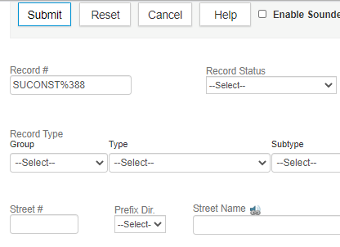
How to Add Billable Time in Accela (continued)
In Entity Type, select Workflow
In Reference Record, click the search (hand) icon
In Record #, enter the record #
Click Submit. Your validated record number is returned
6
3
4
5
SUSIP0000779
Notes:
Select Workflow from the Entity Type dropdown. If the Reference Record number defaults with the record you want, skip the rest of the steps on this slide. Let’s assume that it doesn’t default the correct record. What do you do? Click the hand icon next to the Reference Record field. A form comes up that allows you to search for a record. Any field or combination of fields can be used to perform the search. Let’s assume you know the record number, so you will use that field. You don’t have to remember how many zeroes are in a record number - simply use the wildcard (%) where the zeroes display. Submit the form. If a popup displays, select the record you want and click Select. The validated number then displays in the Reference Record field.

Slide 47
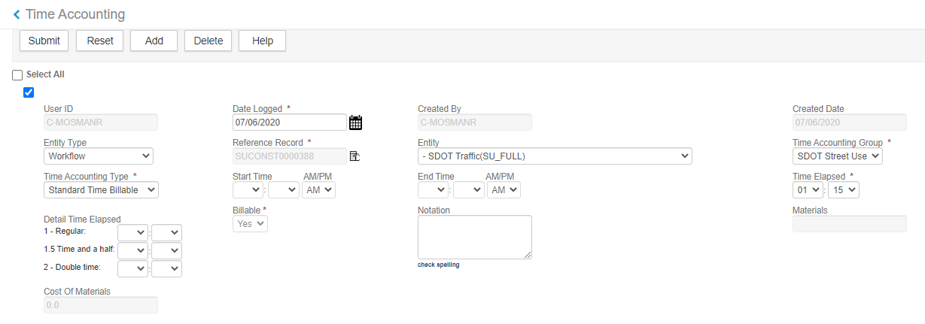
How to Add Billable Time in Accela (continued)
In Entity, pick your group’s secondary review task
In Time Accounting Group, verify SDOT Street Use (the default is okay unless your Group has its own Time Accounting Group)
In Time Accounting Type, select Standard Time Billable
In Time Elapsed, select the hours and minutes worked (in 15-minute increments)
Optional: Enter a comment in Notation. This appears on the invoice
Click Submit
12
7
8
9
- SPU Engineering (SU_SIP_SUB_DR)
10
11
Notes:
Select your group’s secondary review task from the Entity dropdown. SDOT Street Use defaults in the Time Accounting Group. Select your group, if it is different from what defaults.
In Time Accounting Type, select Standard Time Billable for time spent during normal working hours, (do not use Track Non-Billable Time, or Overtime (per Melody Overtime is not charged)). Enter the hours and minutes you worked in Time Elapsed. Minutes should be in 15-minute increments. Optionally enter a comment in Notation. This comment displays on the customer invoice. Submit the form.

Slide 48
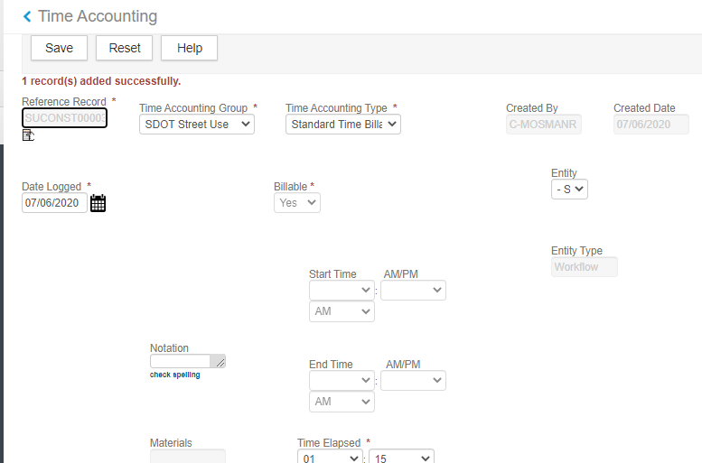
How to Add Billable Time in Accela (continued)
You get a record added successfully message
Click the blue back arrow to return to the Time Accounting page
Your time entry now displays on the page and is Unlocked
14
13
15
Notes:
When the time entry is added successfully, you get a message saying the record was successfully added. Click the blue back arrow to get back to the Time Accounting page. The time you entered now displays in your list.

Slide 49
DEMO |
Open record from My Tasks
Navigate to Workflow
Show multiple tasks open, open –SPU Survey
Add Time
Status Task
Navigate to Time Accounting

Slide 50
Helpful Accela Job Aids
JA 001: Getting Around Accela Back Office
JA 002: Searching in Accela
JA 003: How to Add or Adjust My Time (in an active task)
JA003b: How to Add or Adjust My Time Using Time Accounting
JA403: How to Update Accela as a Secondary Reviewer

Slide 51
Questions

Slide 52
Thank you for your participation

